Slide 1
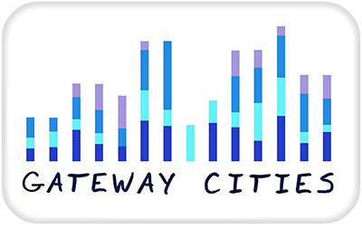
An Analysis of Provincial and Institutional Policy around the Inclusion of Marginalized Students in Ontario Post-Secondary Education
Karen Robson, Paul Anisef, Sam Tecle (York University)
Lisa Newton, Robert S. Brown (Toronto District School Board)
This work was funded by the Ontario Ministry of Training , Colleges and Universities.

Slide 2
Our Project Background
An earlier 2013 OHCRIF Project- Identifying the Complexities of Barriers Faced by Marginalized Youth in Transition to Post-secondary Education in Ontario (2014)

Slide 3

Narrowing the focus
In particular, following suggestions from Museus and Griffin (2011) around the best practice of implementing intersectionality frameworks to PSE policy, we give particular focus to if and how energies have been invested in two marginalized groups that we have previously identified as being the least likely to transition to PSE:
  1) Black males and
  2) students with special education needs from low-income groups.

Slide 4
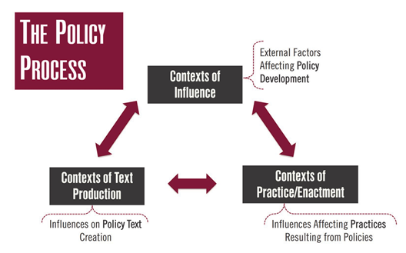
Policy Definition
Policy: a process of becoming, changing from the outside in and inside out. This process involves bidirectional flows between
    contexts of policy text production (e.g. factors influencing policy text such as other policies, personalities, and backgrounds of policy actors),
    contexts of influence ( e.g. other policies, resources, networks, community and place specific factors)
    contexts of practice (e.g. power dynamics among policy actors) (Bowe, Ball & Gold (1992). (Ball, 2012:4)

Slide 5
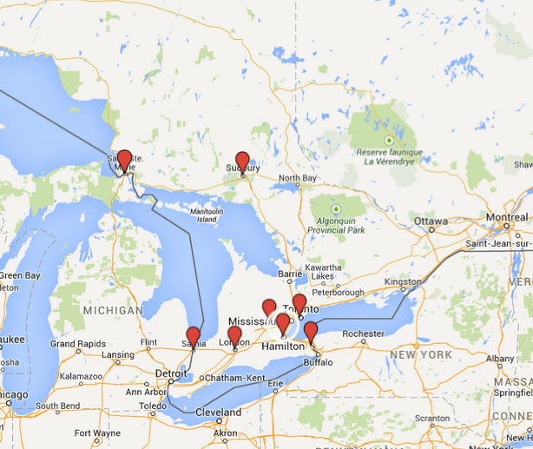
Methods
Textual analysis of policy documents from TDSB, Ministry of Education, Ministry of Training, Colleges and Universities 1993-2013
Analysis of institutional policies of 25% sample of colleges and universities in Ontario
Analysis of Multi Year Accessibly Report Backs

Slide 7
Some key findings
Gaps in policy somewhat overlapping political regimes, lack of PPMs around these issues in Harris years (no surprise)
SEN has taken a major place in issues of access within EDU, other status traits are not so well-considered (e.g. race, socioeconomic status)
Discuss of “barriers” in 2000s, suggesting that outcomes of students not completely understood as meritocratic process, however, subsides with increase of talk in “access”
Access is an interesting term – increased use really one of targeting marginalized groups or a neoliberal catchall to increase bums in seats?

Slide 8
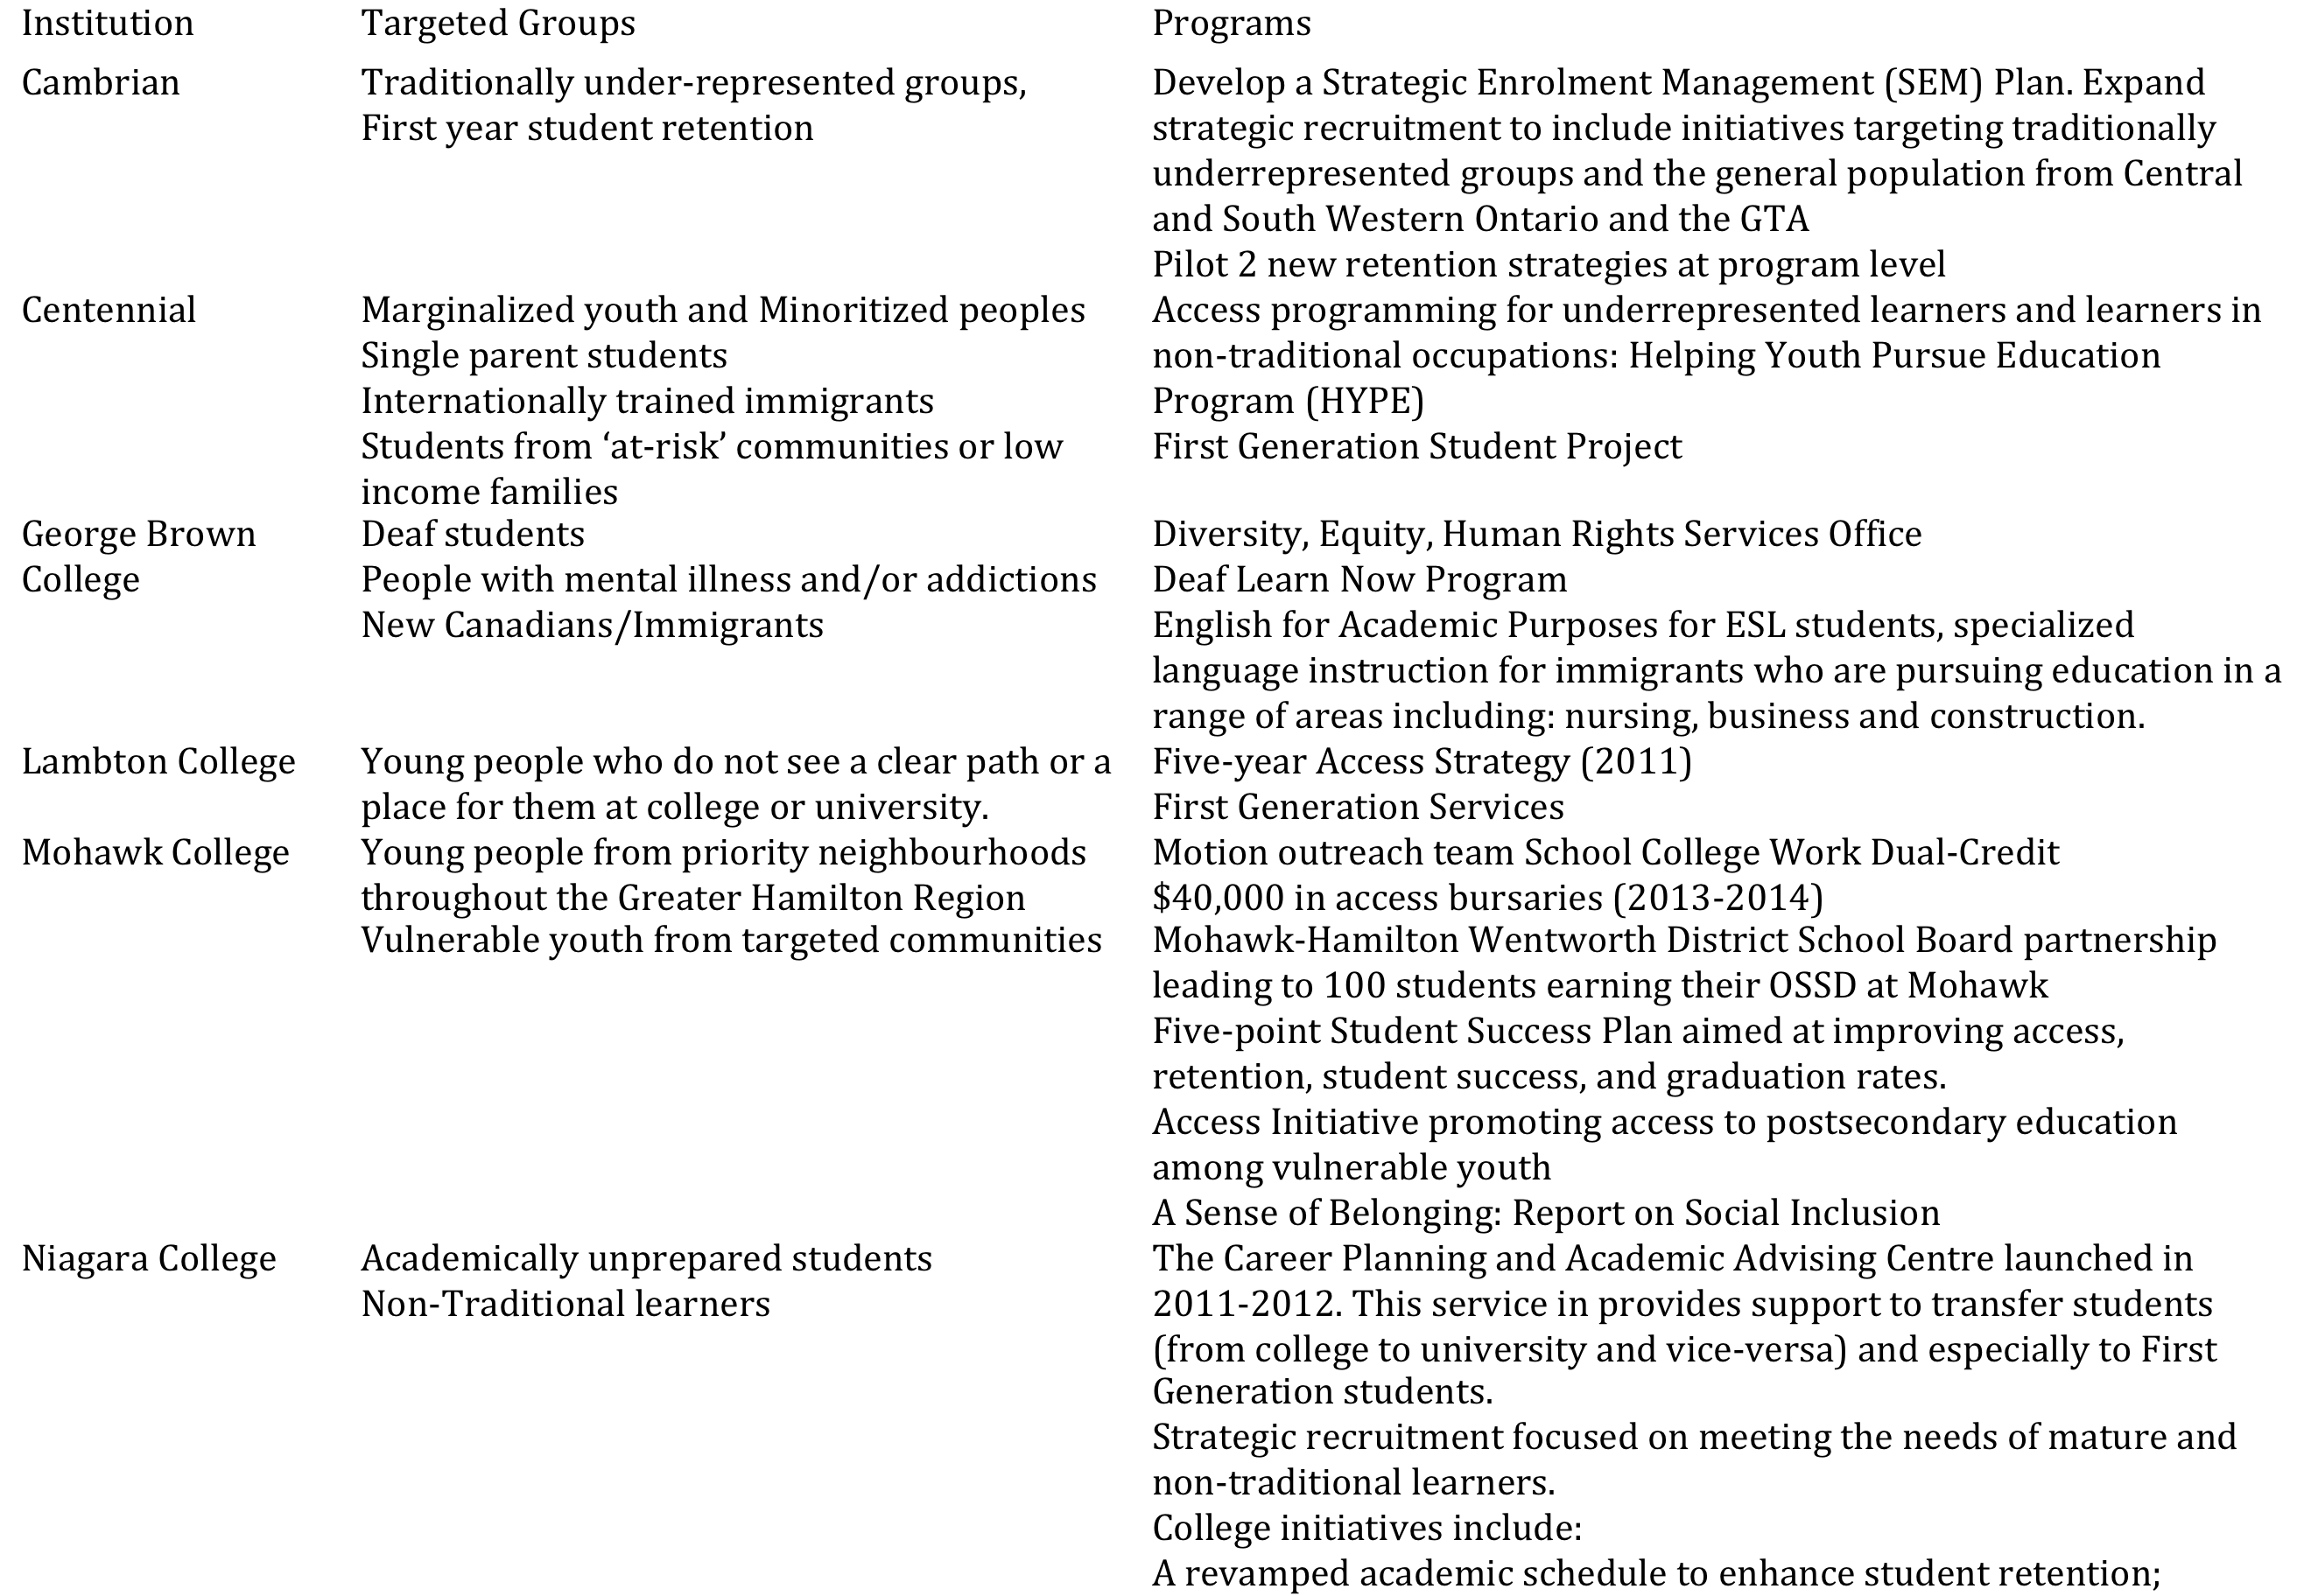
Section II: PSE Institutions
Key Findings

Slide 9
Section II: PSE Institutions
Key Findings
policies and/or programs have been implemented that heavily focus on one axis of difference, for example low income, or Aboriginal, Crown Wards, or First Generation.
  Interesting to note that “first generation” itself can encompass many characteristics, as can “Crown Wards”
do the latest policies designed by the Ministry (Reaching Higher, MYAA’s, Ontario’s Differentiation Policy and SMA’s) engender a policy climate that forecloses an approach that considers multiple barriers experienced by students, ie, an intersectional perspective?

Slide 10
Analysis of multiyear accountability reports
Differentiation Framework (2013):
-increase accessibility, quality, accountability of PSE
ACCESS →
Type 1 (overall)
Type 2 (targeted)
Access as used in Ministry documents can often refer to technology towards streamlining (i.e. improving student transfer of credits and mobility between colleges and universities) rather than increasing access for underrepresented groups. The expansion of online course learning and implementing increased use of technology is highlighted and celebrated by the Ministry as proliferating the choices available for students and this quite likely is see viewed by institutions as a large step forward in both Type I and Type II accessibility, but these approaches do not directly apply intersectional approaches that specifically target at-risk students, particularly racialized students

Slide 11
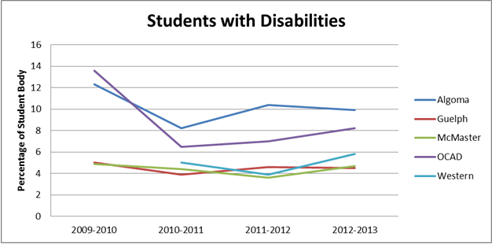
MYAA Report Back data analysis

Slide 12
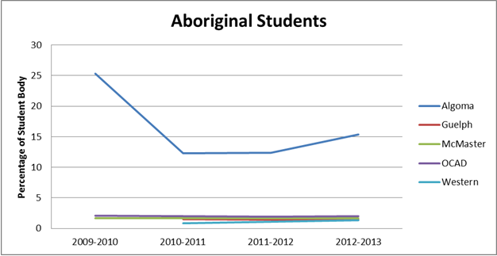
MYAA Report Back data analysis

Slide 13
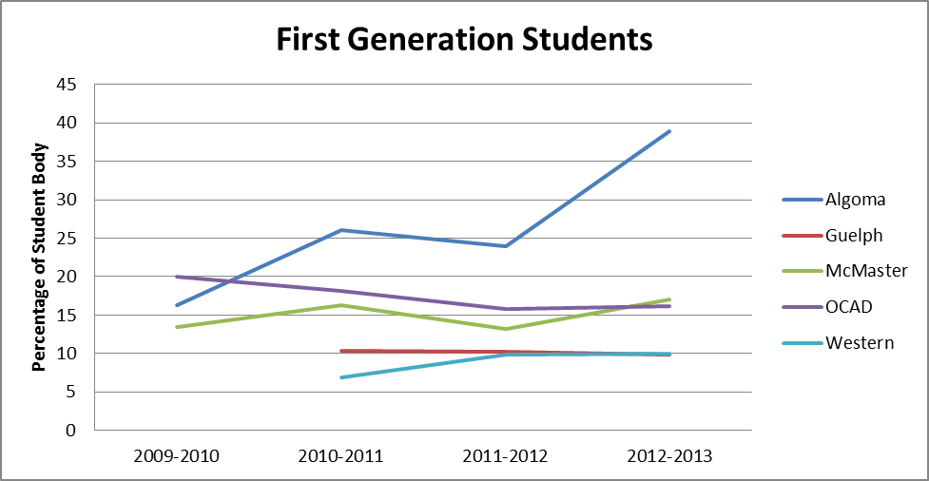
MYAA Report Back data analysis

Slide 14
Students with disabilities
Aboriginal Students
First Generation Students
Francophone students
BUT WHY?

Slide 15
report commissioned by HEQCO in 2011, Finnie, Childs, and Wismer report:
In summary, for some of the under-represented groups, Ontario does not compare favourably to the rest of Canada. In particular, Aboriginal and disabled youth are less likely to attend university if they are from Ontario as compared to other provinces and regions. Conversely, family income seems to matter less in Ontario than in at least some other provinces and regions (Atlantic Canada and Quebec). Having no family history of PSE matters substantially more in Ontario than in the West, and in some cases, more than in Quebec and Atlantic Canada, depending on the particular specification. These different patterns may, in fact, be linked and there may be a relationship between the smaller effects of family income and the greater effects of some of the other factors on under-represented groups in Ontario. (p. 49, emphasis added)

Slide 16
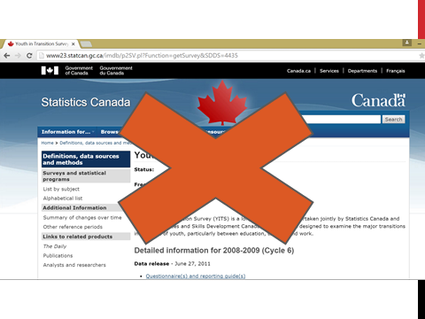
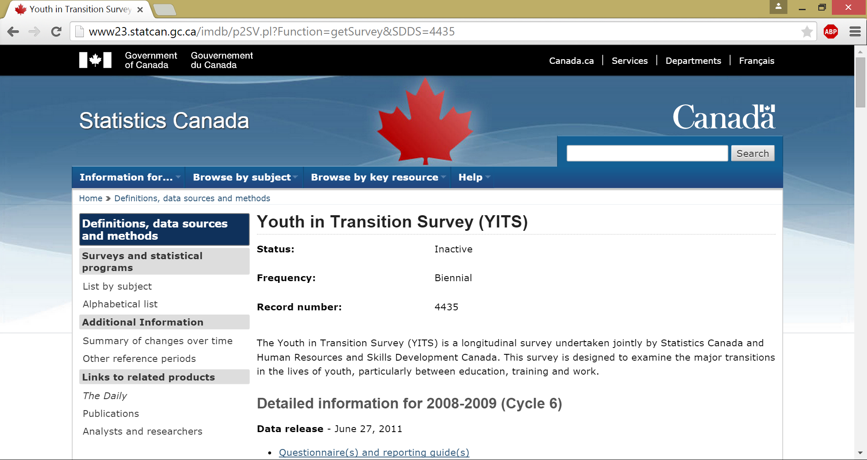
Evidence derived from youth in transition survey

Slide 17
Visible minority
Critics have also pointed out that in cities with large immigration trends, the term “visible minority” hardly makes sense, particularly when racialized persons make up the majority of the population. Using “White” as the unspoken benchmark of comparison is not useful, particularly in highly heterogeneous regions of the country (Bauder, 2001).
Educational attainment is not a White/Non-White issue.

Slide 18
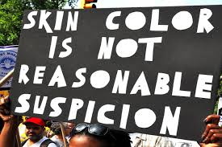
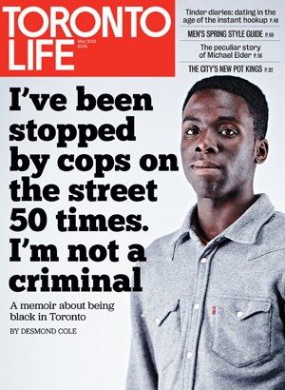
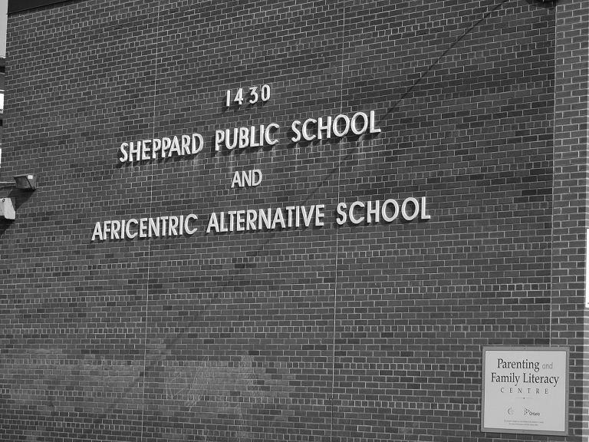
race

Slide 19
Intersectionality as a policy framework
Often thought of as VERY complicated
It’s not!

Slide 20
race

Slide 23


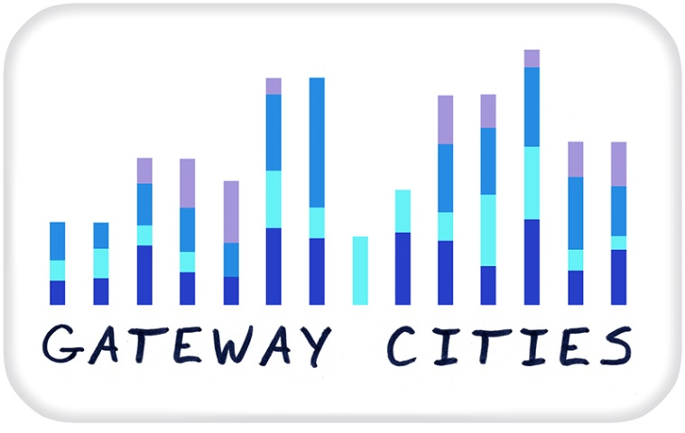

Thank you!
klrobson@yorku.ca
gatewaycitiesproject.info.yorku.ca

Slide 24
References
Ball, S. J., Maguire, M., & Braun, A. (2012). How schools do policy: Policy enactment in the secondary school. London, England: Routledge.
Hankivsky, O. (Ed.). (2012). An Intersectionality-Based Policy Analysis Framework. Vancouver, BC: Institute for Intersectionality Research and Policy, Simon Fraser University. http://www.sfu.ca/iirp/documents/IBPA/IBPA_Framework_Complete%20Collection_Ha nkivsky_2012.pdf
Museus, S., and Griffin, K. 2011. Mapping the Margins in Higher Education: On the Promise of Intersectionality Frameworks in Research and Discourse. New Directions for Institutional Research 151:5–13.
Robson, K., Brown, R., Anisef, P. (2014). Identifying the complexity of barriers faced by marginalized youth in transition to post-secondary in Ontario. (Research Report No. 13/14-07). Toronto, Ontario, Canada: Toronto District School Board.

