Slide 1
Have Post-Secondary Access Policies Have Helped Marginalized Youth?
Karen Robson (York University), Robert S. Brown (Toronto District School Board), and Paul Anisef (York University), Rhonda George (York University)

Slide 2
A continuation of previous research
Our analysis of 2006 Toronto district school board data revealed that later-life post-secondary transition rates of students varied significantly by race, class, and gender. (Robson, Anisef, Brown, & Parekh, 2014)
Specifically, black males were far less likely to go on to postsecondary compared to other groups.
Have things improved?

Slide 3
Data
Toronto District School Board Student Census data
2006 and 2011 (different cohorts)
Age appropriate Grade 12 students
Merged with administrative records
Merged with information on applications and offers of admission from Ontario colleges and universities for 4 years

Slide 4
Racial Composition of Samples (%)

Slide 5
Within-Group % of students with Special Education Needs

Slide 6
Within-Group % in Majority Academic Courses

Slide 7
Average Grade 11/12 marks
Pretty consistent 2% grade inflation across the groups

Slide 8
University confirmations, 2006 and 2011

Slide 9
Difference between 2011 and 2006 (university confirmations)

Slide 10
College confirmations, 2006 and 2011

Slide 11
Difference between 2011 and 2006 (college confirmations)

Slide 12
2011 to 2006 difference in confirming neither university or college

Slide 13
Log odds of going to University – unadjusted (controlling for nothing)

Slide 14
Log odds of going to University –adjusted (controlling for things*)
*special needs, sex, generation of immigrant, parental postsecondary education, grade 11/12 marks, neighbourhood income, academic stream, enjoyment of school, race, school size.

Slide 15
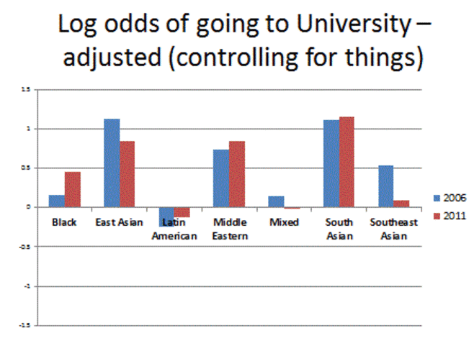


Slide 16
Log odds of going to college – unadjusted (controlling for nothing)

Slide 17
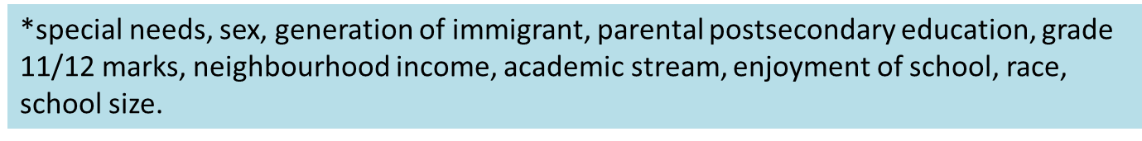
Log odds of going to college –adjusted (controlling for things*)

Slide 18
Interactions
In 2006:
SNxIncome (university and college)
Parental income positively associated
SNxParentsPSE (college)
SNXblackXapplied (college)

Slide 19
2006- Average Probabilities of Confirming College - Interaction of Black*SEN*Applied

Slide 20
2006 - SN * Income

Slide 21
Interactions
In 2011
SNXapplied (university)
blackXapplied (university)
snXparentspse (college)
snXincome (college)

Slide 22
2011- Average Probabilities of Confirming University with Race, SEN and applied interactions

Slide 23
2011- Interaction of SN and Parental PSE on College Confirmations

Slide 24
2011 - Neighbourhood income and probability of confirming college

Slide 25
Summary
When we look at the different predictors of post-secondary, Black students are way less likely to have what is required to go
lower grades
higher rates of special education needs
Less likely to be in academic streams
This has not changed between 2006 and 2011.

Slide 26
But what has changed?
Controlling for all “that stuff”, black students actually have a higher likelihood of going to university compared to white students now

Slide 27


In other words

Slide 28

WHY?
Things are getting better? (Policies are working!)

Slide 29
A shift in the composition of ethnic groups – “immigrant drive”

Slide 30
Note: Excerpt from policy analysis by Robson, Anisef, Newton and Tecle, 2015)
Maybe the policies worked! \_(ツ)_/¯

Slide 31
Breakout groups
Discussion questions:
How do you interpret the changes observed between 2006 and 2011 ?
What are the policy implications of these findings?
What are the practice implications of these findings?

Slide 32




Rob.Brown@tdsb.on.ca
gatewaycitiesproject.info.yorku.ca

Slide 33
References
2014. Robson, K., Anisef, P., Brown, R. S., and Parekh, G. “The Intersectionality of Postsecondary Pathways: The Case of High School Students with Special Education Needs” Canadian Review of Sociology, 51(3), 193-215.
2015. Robson,K., Anisef, P., Newton. L. and Tecle, S. “An Analysis of Provincial and Institutional Policy around the Inclusion of Marginalized Students in Ontario Postsecondary Education” MTCU Research Report.

